Slide 1
Belarc Advisor vs cpuz Utility
Belarc is a secure software that provided a detailed profile of the hardware and software components of their computer

Slide 2
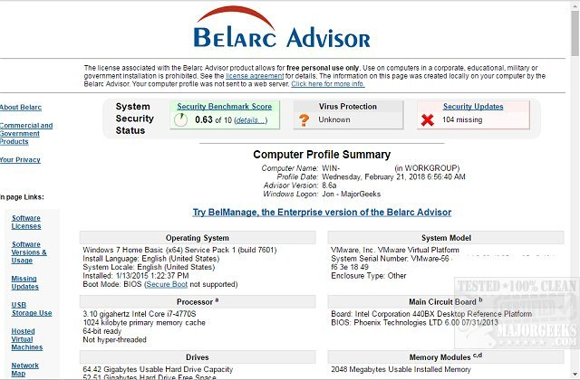
Belarc
A secure software that
provided a detailed profile
of the hardware and
software components of
their computer

Slide 3
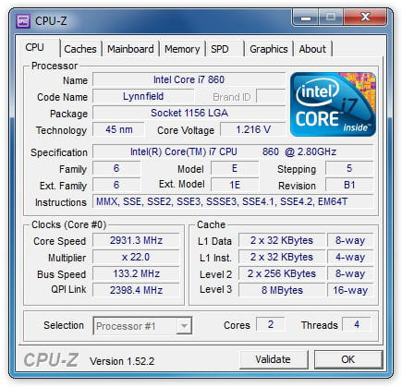
CPU-Z Utility
A software that profiles and monitors applications such as the Ram, mother board and hard drives specifically for windows and androids.

